Slide 1
Chapter 01 (Part 02)
Topic:
The Entrepreneurial Mindset

Slide 2
What is mindset?
Mind + Set

Slide 3

Mind
The ability to think and imagine
Set
Group of things

Slide 4
What is mindset?
Mindset
  A mindset refers to a set of assumptions, methods or notations held by one or more people or groups of people which is so established that it creates a powerful incentive within these people or groups to continue to adopt or accept prior behaviors, choices, or tools.
  This phenomenon of cognitive bias is also sometimes described as mental inertia, "groupthink", or a "paradigm", and it is often difficult to counteract its effects upon analysis and decision making processes.

Slide 5
What is mindset?
According to Dr. Carol Dweck* from Stanford University, US, there are two sets of mindset:
  A fixed mindset
  A growth mindset
*Source: Carol C. Dweck (2006), Mindset: The New Psychology of Success, Random House

Slide 6
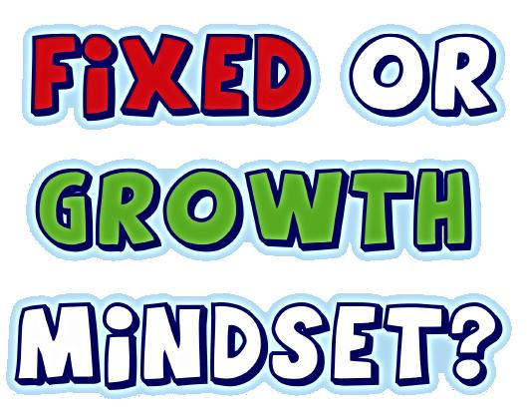
21-03-2015

Slide 7
What is mindset?
In a fixed mindset, people believe that their basic qualities, like their intelligence or talent, are simply fixed traits (rigid). They spend their time documenting their intelligence or talent instead of developing them. They also believe that talent alone creates success—without effort.

Slide 8
What is mindset?
In a growth mindset, people believe that their most basic abilities can be developed through dedication and hard work—brains and talent are just the starting point. This view creates a love of learning and a resilience that is essential for great accomplishment. Virtually all great people (including entrepreneurs) have had these qualities.

Slide 9
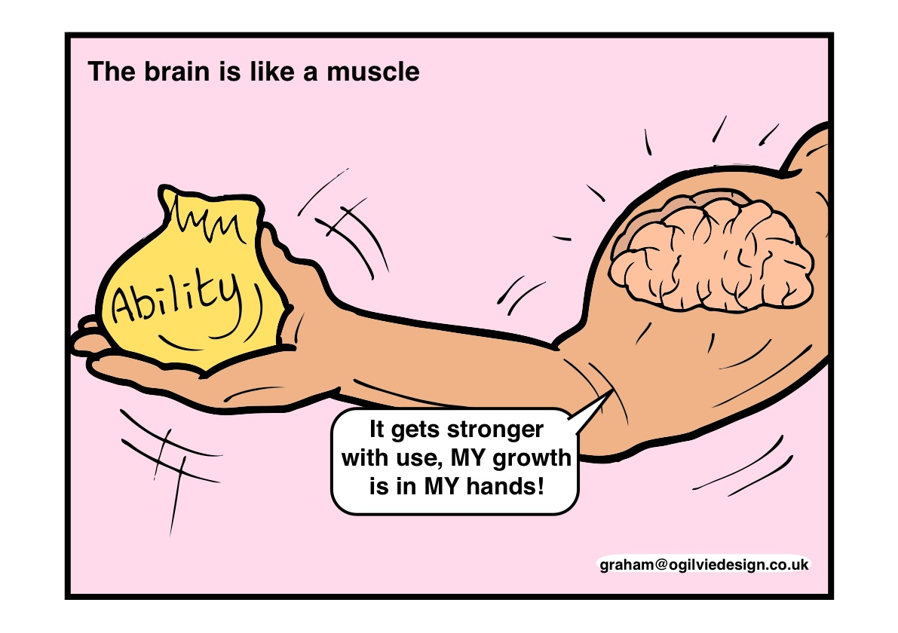
21-03-2015

Slide 10
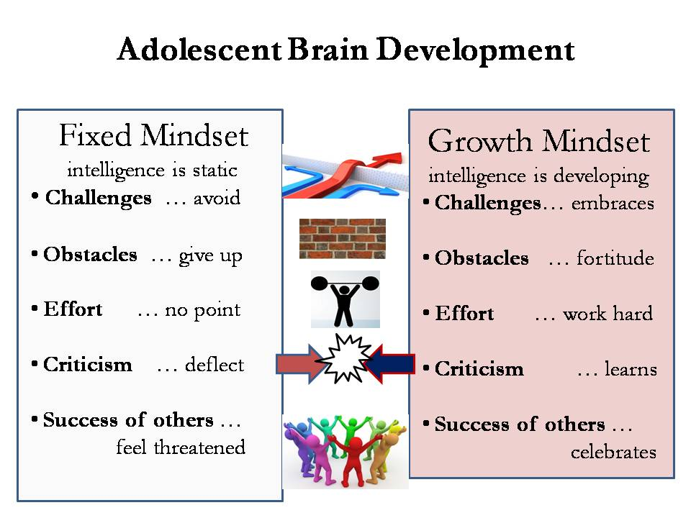
21-03-2015

Slide 11
Successful entrepreneurs
Bill Gates - Microsoft
Anita Roddick – Body Shop
Konosuke Matsushita - Panasonic
Steve Job – Apple
Soichiro honda - Honda
Akio morita - Sony
others?.

Slide 12
Can mindset be changed?
Although people may differ in every which way—in their initial talents and aptitudes, interests, or temperaments BUT everyone can change and grow through application and experience.
The passion for stretching yourself and sticking to it, even (or especially) when it’s not going well, is the HALLMARK of the growth mindset. This is the mindset that allows people to thrive during some of the most challenging times in their lives.

Slide 13
What is Entrepreneurial Mindset?
Is a set of cognitive (thinking) processes that triggers the individuals to act or to behave entrepreneurially.
  Sometimes it is called entrepreneurial talent or mentality
  This mindset, talent or mentality can be changed and modified over time
  The basis for the individual behavior

Slide 14

Entrepreneurial Mindset
Having the right attitude:
  Able to work without supervision
  Able to self-motivate
  Able to make quick decisions
  Able to handle stress
  Open-minded and flexible
  Focused
  Persistent
  Patient, etc.

Slide 15
Mindset and Behavior
Functional knowledge
Entrepreneurial skills
Managerial skills
Technical skills
Communication skills
IT skills
Intrinsic
  Intention
  Spirit
  Responsibility
Extrinsic:
  Role Model
  Rewards
Knowledge &
Skills
Motivation
Pro-active
Positive values
Propensity to take risk
Creative and innovative
Inquisitive mind
Pursuing excellence
Attitude
Mindset affects the individual behavior at all levels

Slide 16
Mindset and Behavior
BEHAVIOR
(Explicit)
MINDSET
(Tacit)
APTITUDE
(Implicit)

Slide 17
Examples of Entrepreneurial Mindset
1. J.K. Rowling: J.K. Rowling's journey embodies the entrepreneurial mindset, where opportunities are identified, creativity is harnessed, and setbacks become stepping stones to success. Struggling as a single mother, Rowling showcased her creativity by penning the first Harry Potter book. Undeterred by rejections, she tenaciously refined her writing until the breakthrough success of the Harry Potter series. Rowling's resilience in the face of challenges is a testament to the power of an entrepreneurial mindset in transforming adversity into triumph.

Slide 18
Examples of Entrepreneurial Mindset
2. Oprah Winfrey: Oprah Winfrey's evolution from a talk show host to the helm of a media empire underscores the impact of an entrepreneurial mindset. Her journey is marked by resilience, continuous learning, and innovative thinking. Winfrey seized opportunities, notably with the creation of her television network, OWN, and consistently expanded her influence. Her unique voice and unwavering commitment to personal and professional growth exemplify the transformative power of an entrepreneurial mindset in building an influential and globally resonant brand.

Slide 19
Examples of Entrepreneurial Mindset
3. Steve Jobs: Steve Jobs, as the co-founder of Apple, epitomized the entrepreneurial mindset through proactive initiative, adaptability, and innovative problem-solving. In the face of financial challenges in the early 1990s, Jobs took charge by restructuring Apple and focusing on groundbreaking products like the iMac and iTunes. His ability to think beyond conventional boundaries, take calculated risks, and adapt to dynamic market conditions showcases the essence of an entrepreneurial mindset. Jobs' legacy serves as a testament to the transformative impact of entrepreneurial thinking on reshaping industries and driving innovation.

Slide 20
The Importance of Entrepreneurial Mindset
To cope with the rapidly changing economy.
  Business/economic environment today has become fuzzy, chaotic/messy, complex, uncertain and change very rapidly.
  To succeed in the mindst of this chaos and uncertainty we require the agility, creativity, flexibility, innovation, interdependence and vision of entrepreneurs and their enterprising units.

Slide 21
The Importance of Entrepreneurial Mindset
To build an entrepreneurial society
  Developing the right mindset at a very early age
  Inculcation and acculturization process need to implemented through various programs and activities
  Entrepreneurs as agents of change at every level of the society
  Important contribution to entrepreneurial capital
  Entrepreneurship as a way of life

Slide 22
Building an Entrepreneurial Society
ECONOMIC
GROWTH
ENTREPRENEURIAL
ECONOMY
-Higher output
-Higher income per capita
-Higher standard of living
-Full employment
-Vibrant
-Sustainable
-Added value
-Job creation
-Higher
productivity
ENTREPRENEURIAL
CAPITAL
-Human
-Knowledge
-Intellectual
-Physical
-Financial
-Social
ENTREPRENEURIAL
SOCIETY
ACCULTURIZATION
PROCESS
-Risk-taker
-Innovative
Creative
Supportive
Changing the mindset
Building the culture

Slide 23
The Importance of Entrepreneurial Mindset
To spur/encourage innovation and growth
  From creative people, comes creative products
  Innovation creates and adds value
  Finding new source of economic growth
  Change as process, not destiny
  Thinking “out of the box” becomes norms of the society
  Innovation in every part of the value chain

Slide 24
Ineffective Entrepreneurial Mindset
Don’t care attitude
Not being meticulous/ takes thing for granted)
Passing the buck
Why should I care?/ Careless attitude

Slide 25
Ineffective Entrepreneurial Mindset
Wait and see
Non-punctuality
Subsidy mentality
Ask more, give less

Slide 26
Developing an Effective Entrepreneurial Mindset
1. Develop Resilience, Tenacity, and Motivation
These attributes serve as the bedrock, enabling individuals to rebound from setbacks, maintain unwavering determination in pursuit of goals, and sustain motivation in the face of challenges. By cultivating these fundamental qualities, individuals lay the groundwork for a mindset that not only withstands adversity but thrives on it.

Slide 27
Developing an Effective Entrepreneurial Mindset
2. Adopt a Positive Attitude
The cornerstone of a successful entrepreneurial mindset lies in adopting a positive attitude and harnessing the power of positive thinking. By maintaining optimism and a can-do mentality, individuals fortify themselves to navigate obstacles and setbacks effectively. This positive orientation becomes a catalyst for success, fostering resilience and shaping a mindset that views challenges not as insurmountable obstacles but as opportunities for growth and learning.

Slide 28
Developing an Effective Entrepreneurial Mindset
3. Embrace Challenges:
At the heart of developing an entrepreneurial mindset is the willingness to embrace challenges as opportunities for growth and learning. Challenges, when approached with the right mindset, become platforms for innovation and creativity. This perspective shift is crucial for personal and professional development, encouraging individuals to view challenges not as roadblocks but as stepping stones to unlock their potential and drive transformative change.

Slide 29
Developing an Effective Entrepreneurial Mindset
4. Cultivate Key Characteristics: Nurturing an entrepreneurial mindset involves the focused cultivation of key characteristics that define successful entrepreneurs. Traits such as risk-taking, goal orientation, creative problem-solving, perseverance, resilience, and customer-centricity are essential for thinking and acting like an entrepreneur across diverse situations. Developing these traits lays the groundwork for a mindset that thrives in dynamic environments and paves the way for innovative thinking and strategic decision-making.

Slide 30
Developing an Effective Entrepreneurial Mindset
5. Be Creative, Communicative, and Open to Risk: The multifaceted nature of the entrepreneurial mindset necessitates individuals to be creative, communicative, highly motivated to succeed, open to risk-taking, and accepting of failure. This triad of characteristics forms the essence of entrepreneurial thinking, enabling individuals to innovate, communicate effectively, take calculated risks, and learn from setbacks. Cultivating this comprehensive set of attributes empowers individuals to navigate the complexities of the entrepreneurial journey with agility and resilience.

